Slide 1
Youth Leadership in Prevention Program

Slide 2
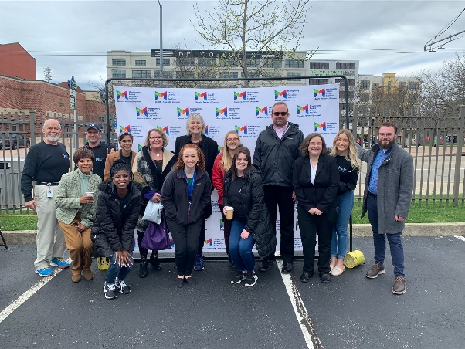
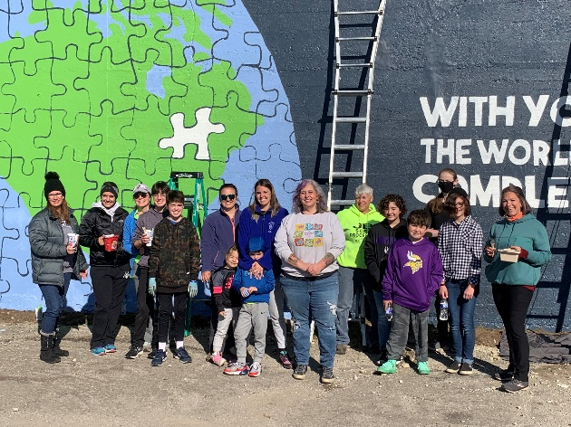
The Montgomery County Prevention Coalition
300 volunteers from all across Montgomery County
Working to reduce substance use and promote wellness
Prevention professionals, community leaders, business owners, law enforcement, parents, teachers, concerned citizens
Much of our work is targeted toward youth, so we can’t do this work without them!

Slide 3
The Montgomery County Prevention Coalition

Slide 4
Goals of the YLP Program
Meet our youth where they are
Promote peer-to-peer prevention
Help youth tailor prevention messaging to the culture and needs of their school and community
Foster the next generation of preventionists!

Slide 5
About the YLP Program
Supports grades 6-12
You are building a student leadership team with an adult adviser
Programs will create peer-to-peer supports, prevention messaging and programming that decreases drug and alcohol use and promotes mental wellness
Needs to be student led, but supported by adults.
Must feature a drug and alcohol component
Can be applied to new or existing programming

Slide 6
About the YLP Program
With support from the Coalition, students in this program will:
Learn the science and importance of prevention
Understand the scope of mental and behavioral health in their schools, and learn signs and symptoms
Implement proven techniques to mitigate substance use and mental health disorders
Get tips to communicate effectively with their peers
New this year! Each school will designate 1 student to serve on our Youth Advisory Committee to provide feedback on this program and other MCPC inititiatives.

Slide 7
Application Timeline
March 16: Application Released
May 1: Application Closes
June 1: Notice of Award Sent
August 1: Funding Cycle Begins
June 30: Funding Cycle Ends
Additional dates and deadlines for the year can be found on the Request for Proposals.

Slide 8
Eligibility
Public, private, and parochial middle and high schools in Montgomery County
Will collect data and outcomes through funding cycle and submit to the MCPC twice a year.
Must designate an adult adviser (or plan for filling that role) in application
The MCPC will prioritize one program per district

Slide 9
Funds
$10,000 per awarded application
Funds are given on an invoice process each month
Reimbursement for previous month’s expenses
Due on the 15th of each month
Each building can submit one application.
Funding can be used for staff time, marketing and printing of materials, and implementation of prevention strategies
MCPC will host a training for financial personnel at the beginning of the funding cycle.

Slide 10
Requirements
Fully completed online application submitted by May 1
Project Budget
Signed letter of support from building principal, superintendent or counselor

Slide 11
Criteria for Award
Attend two trainings hosted by Coalition
Advisers will attend quarterly Advisers’ Council Meetings
Need to send designee in place if unable to attend
Report on outcomes and prevention efforts taking place in school. Must have a drug and alcohol component.
With help from Coalition, create a strategic plan for the school year.
Report metrics and final budgets to ADAMHS

Slide 12
Training & Onboarding
The MCPC will offer a menu of training opportunities – each school will do two trainings
Each school will work with their YLP mentor to determine best options for trainings
Quarterly advisers’ council meetings
Quarterly youth advisory council meetings
Youth will be invited to attend two trainings through PreventionFirst!
Support from MCPC members and staff

Slide 13
YLP “Steering Committee”
The MCPC has appointed a Council of Coalition members to serve as the Steering Committee for this program.
This group will:
Advise on the program
Monitor outcomes and successes
Help design training and onboarding for awarded organizations
Mentor participating programs
Make recommendations for future opportunities and improvements
Coming soon! Nominations for 1-2 youth to be involved on this committee!

Slide 14
Tips & Tricks for applying!
Email Colleen after you submit to make sure it went through or ask to be emailed a copy of your responses.
Be as specific as possible in your budget.
Type of materials, number of materials, cost of each
Break down costs required for events
Consider including stipends for advisers (usually around $500 - $1,000)
If you request for more than 2 advisers, please tell us why!
Funds need to be used for prevention best practices. We will not fund:
Mock car crashes
Drinking goggles
Some speakers with lived experience
Other types of scare tactics
Vape detectors

Slide 15
Next Steps
Be sure to submit your online application (including your letter of support!) by May 1.
If you have questions or would like to chat about ideas for the application, please reach out to Colleen.
Coakes@mcadamhs.org
937-443-0416 x 121

Slide 16
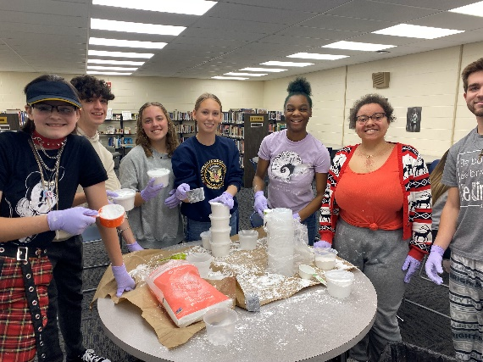
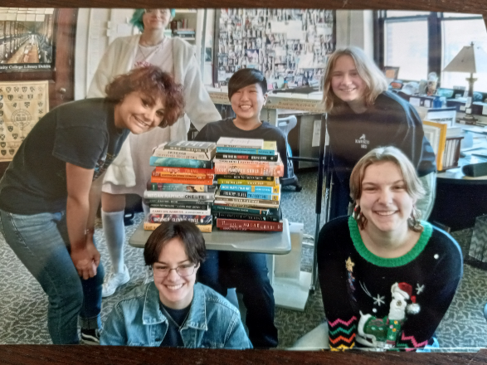
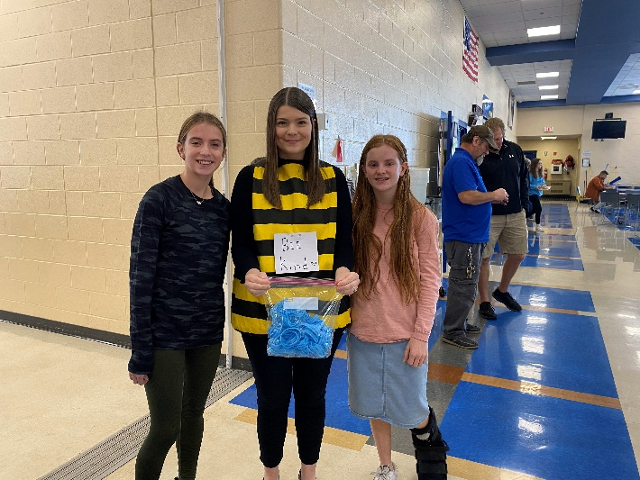
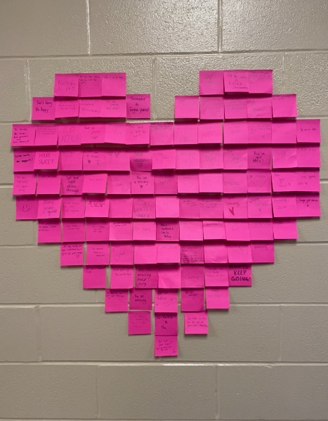
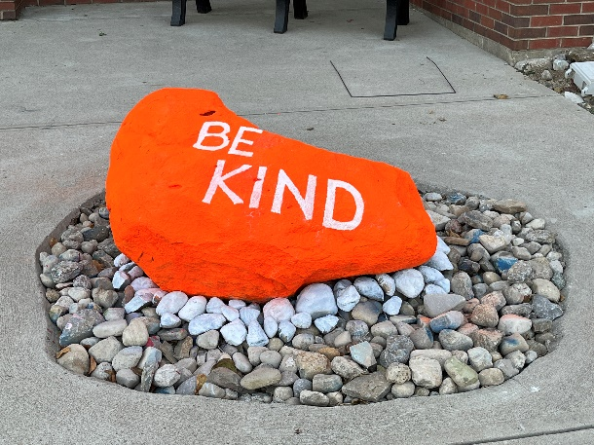
Good luck!

