Slide 1
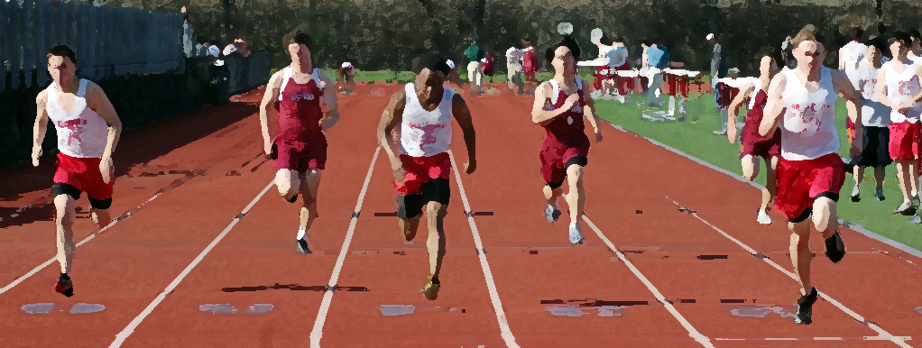
Student Athletes
[ YOUR LOGO HERE]
Prescription Opioid
Misuse Prevention
PARENT EDITION

Slide 2
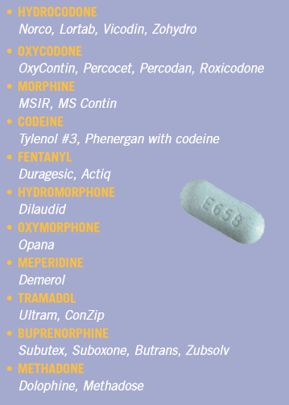
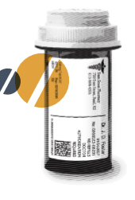
What are opioids?
Prescription pain killers that are powerful and addictive
Similar chemical properties and addictions risks as heroin
Risks?
Psychological dependence or addiction
Unintentional overdose
Serious side effects, such as sedation, nausea, or vomiting
Individuals stealing or accessing your prescribed medications
PHYSICAL DEPENDANCE CAN HAPPEN
IN JUST 7 DAYS

Slide 3
What is prescription medication abuse?
Use of any medication that is not prescribed to you
Taking too much of your prescribed medication or taking it too often
Using a medication for any reasons other than what the prescription states

Slide 4
OHIO STATS

Slide 5
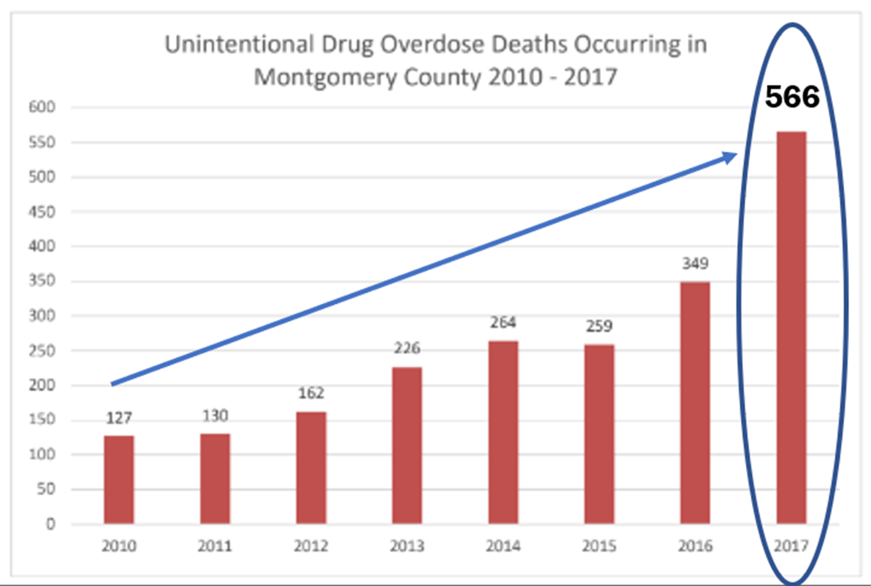
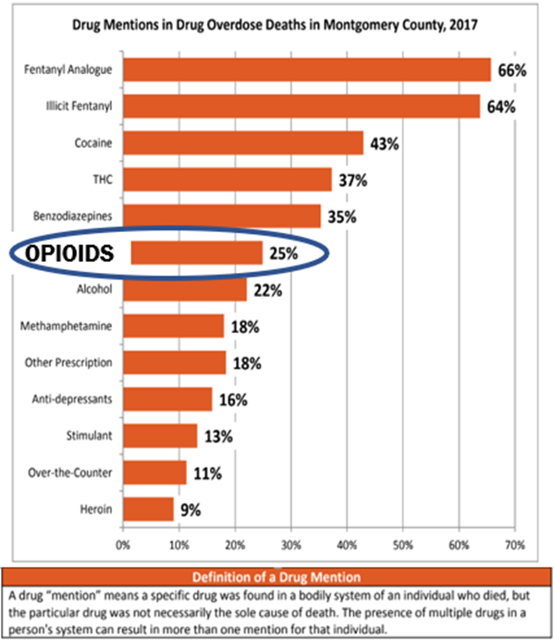
UNITENTIONAL DRUG OVERDOSE FATALITIES
2017

Slide 6
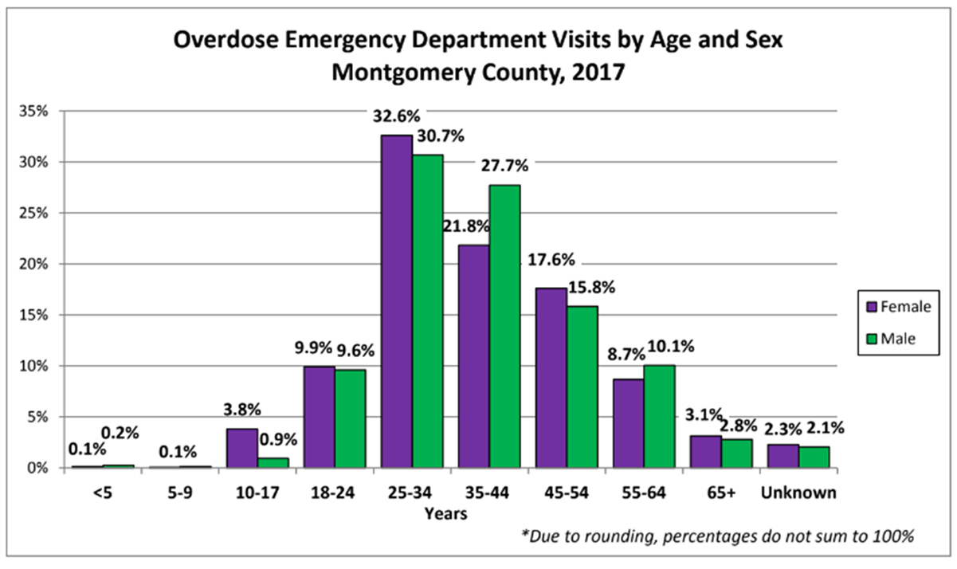
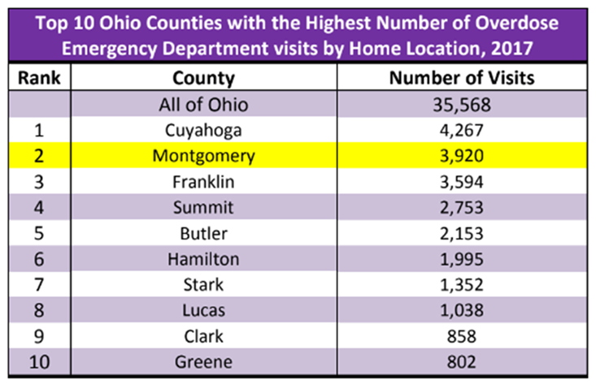
OVERDOSE EMERGENCY
ROOM VISITS
2017

Slide 7
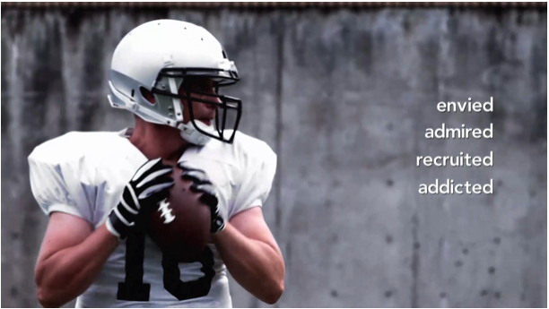
Why are athletes at risk?
2 million high school athletes will be injured this year
Many will be prescribed opioid painkillers
75% of high school heroin users started with prescription opioids
Increased access due to high rates of injury on teams and unsafe medication sharing
A culture of ‘play through the pain’

Slide 8
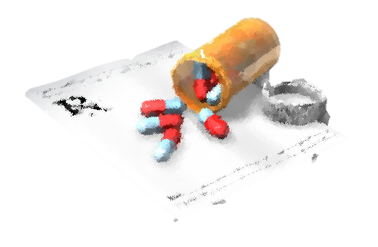
What is prescription medication abuse?
Use of any medication that is not prescribed to you
Taking too much of your prescribed medication or taking it too often
Using a medication for any reasons other than what the prescription states

Slide 9
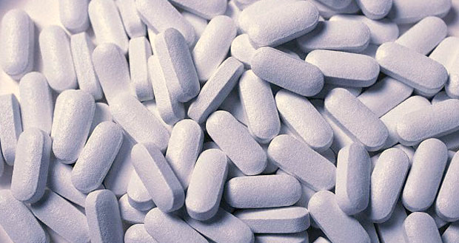
UNSAFE MEDICATION PRACTICES
67-92%
of patients hold onto
unused opioids
73-77%
of people do not lock meds
Only 9% of people
dispose of meds by FDA recommended methods
!
70%
of people who abuse prescription medication source it from friends and family
Bicket, M.C., Long, J.J., Pronovost, P.J., Alexander, G.C., Wu, C.L. (2017) Prescription opioid analgesics commonly unused after surgery: a systematic review. JAMA Surgery; 152(11), 1066-1071

Slide 10
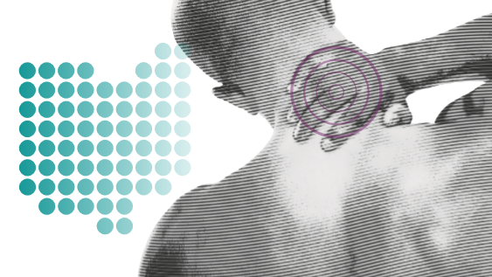
DON’T LET AN INJURY LEAD TO AN OPIOID ADDICTION
Your child got injured…
Now what?

Slide 11
REMEMBER…
EVIDENCE SHOWS OTC MEDICATION MAY WORK BETTER THAN OPIOIDS FOR ACUTE PAIN

Slide 12
ACETOMINOPHEN
ANTI-INFLAMMATORIES
ICE, HEAT
PHYSIOTHERAPY
MASSAGE
ACCUPUNCTURE
NERVE STIMULATION
COMPRESSION
YOGA

Slide 13
AN INJURED ATHLETE NEEDS TIME TO HEAL
DON’T MEDICATE TO PLAY THROUGH PAIN
BREAK THE CYCLE OF INJURY, PAIN,
RE-INJURY

Slide 14
You are in charge of your own health
Know your options
Use alternatives
Ask your care provider questions before prescription
If an opioid is required, use it for the shortest time possible
Take time to heal but still stay involved with the team

Slide 15
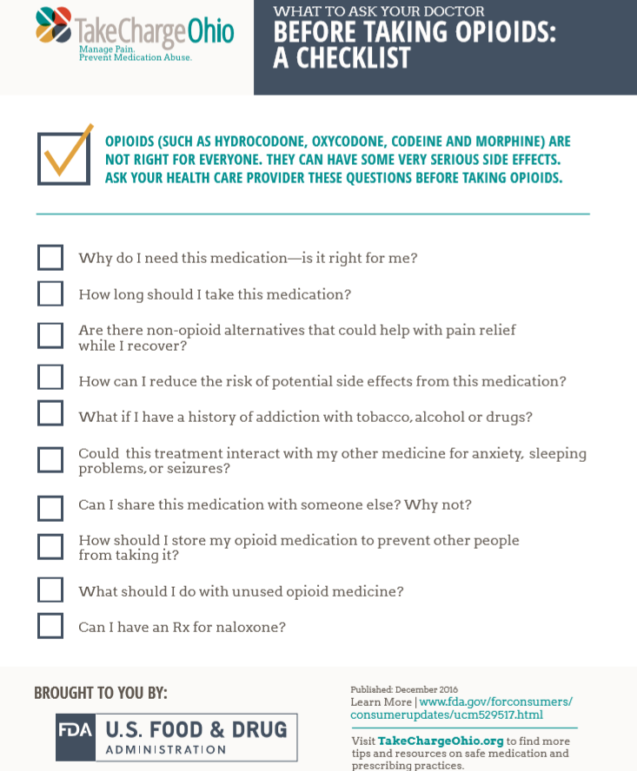
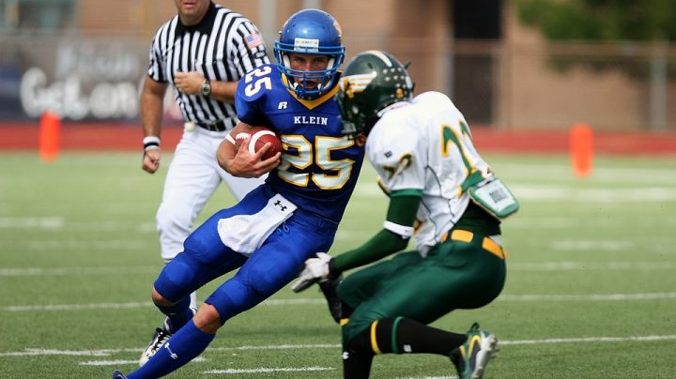
ASK QUESTIONS
BE ENGAGED
TAKE CHARGE

Slide 16
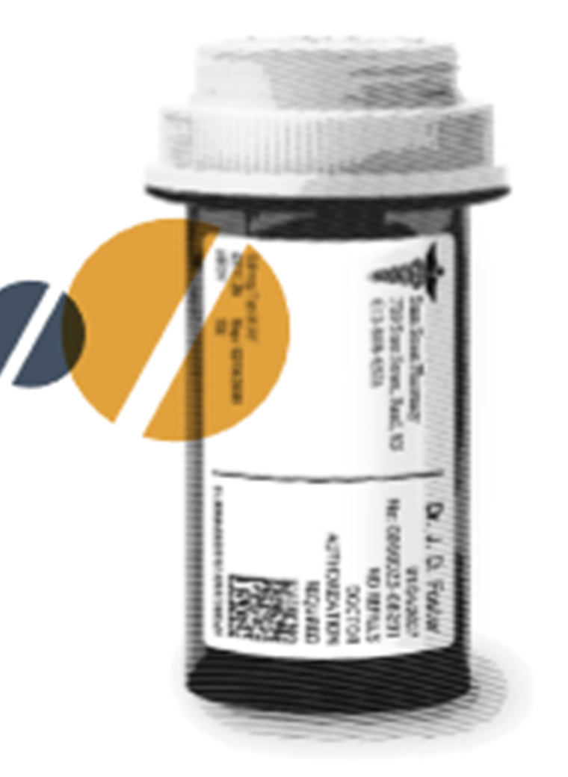
Safe Medication Practices
Only use prescription medications as directed by your healthcare professional
Do NOT share your meds, or take someone else's
Keep your meds safe, and out of someone else’s hands
Model safe medication practices

Slide 18
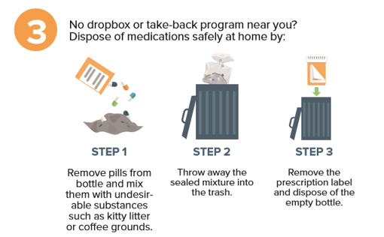
Safe Medication Disposal Options

Slide 19
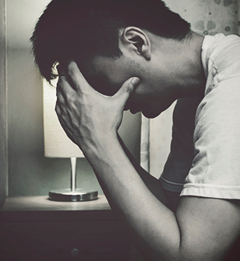
COMMON SIGNS OF DRUG ABUSE
Fatigue, red or glazed eyes, and repeated health complaints
Sudden mood changes
irritability
negative attitude
personality changes
general lack of interest in sports/ team
Secretiveness and withdrawing from family, teammates
Decreased or obsessive interest in school work
Decrease in sports performance
Increase in frustration, losing temper

Slide 20
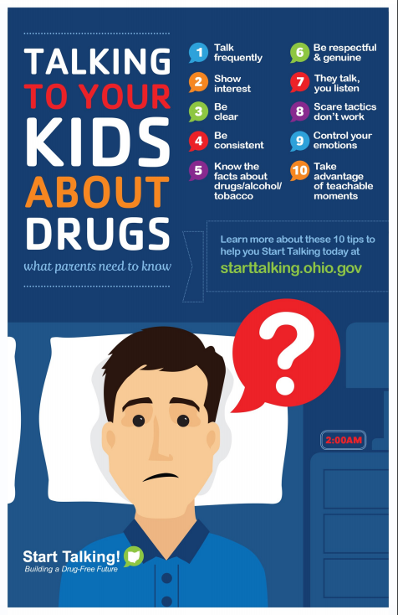
Take Advantage of Teachable Moments
Children are up to 50% less likely to use drugs when their parents talk with them about drug use
Sign up for Know! Parent Tips at PreventionActionAlliance.org

Slide 21
OHSAA Policy on Drugs, Medicine and Food Supplements

Slide 22
RESOURCES
generationrx.org
takechargeohio.org
drugfree.org

